Slide 1
Leadership
Chapter 3 - Skills Approach

Slide 2
Overview
Skills Approach Perspective
Three-Skill Approach (Katz, 1955)
Skills-Based Model (Mumford, et al, 2000)
How Does the Skills Approach Work?

Slide 3
Skills Approach Description
Perspective
Definition
Leader-centered perspective
Emphasis on skills and abilities that can be learned and developed
Leadership skills - The ability to use one’s knowledge and competencies to accomplish a set of goals and objectives

Slide 4
Three-Skill Approach (Katz, 1955)
Technical Skill
Human Skill
Conceptual Skill

Slide 5
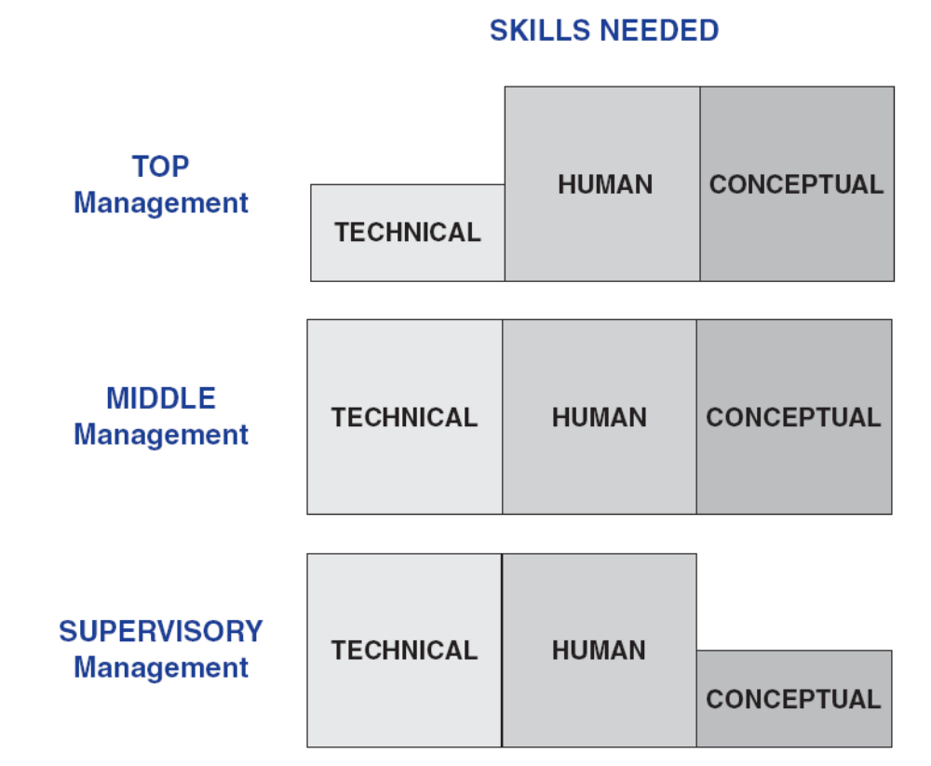
Basic Administrative Skills – Katz (1955)
Management Skills Necessary at Various Levels of an Organization
Leaders need all three skills – but, skill ability/ importance changes based on level of management

Slide 6
Technical Skill
Technical skill - having knowledge about and being proficient in a specific type of work or activity.
  Specialized competencies
  Analytical ability
  Capability to use appropriate tools and techniques
Technical skills involve hands-on ability with a product or process
Most important at lower levels of management

Slide 7
Human Skill
Human skill – having knowledge about and being able to work with people.
  Awareness of one’s own perspective and others’ perspectives at the same time
  People skills help a leader to assist group members in working cooperatively to achieve common goals
  Creates an atmosphere of trust where members feel they can become involved and impact decisions in the organization
  Important at all levels of the organization

Slide 8
Conceptual Skill
Conceptual skill - the ability to do the mental work of shaping meaning of organizational policy or issues (what company stands for and where it’s going)
  Works easily with abstraction and hypothetical notions
  Central to creating and articulating a vision and strategic plan for an organization
  Most important at top management levels

Slide 9
Skills-Based Model
Skills Model Perspective
Skills-Based Model
  Competencies
  Individual Attributes
  Leadership Outcomes
  Career Experiences
  Environmental Influences

Slide 10
Skills Model Description
(Mumford, Zaccaro, Harding, Jacobs, & Fleishman, 2000)
Perspective
Skills-Based Model of Leadership
Research studies (1990s) goal: to identify the leadership factors that create exemplary job performance in an organization
Emphasizes the capabilities that make effective leadership possible rather than what leaders do
Capability model - Examines relationship between a leader’s knowledge & skills & the leader’s performance
Suggests many people have the potential for leadership

Slide 11
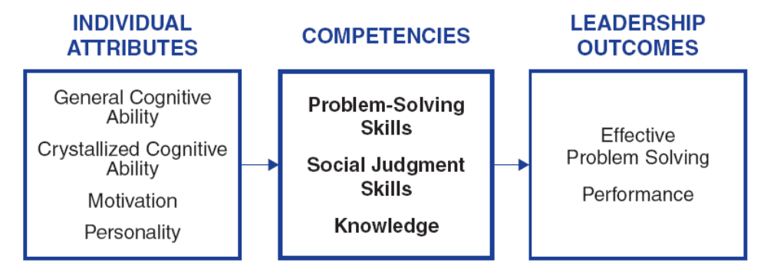
Skills Model
Three Components of the Skills Model

Slide 12
Competency Skills
Competencies
Problem Solving
Social Judgment
Knowledge
Creative ability to solve new/unusual, ill-defined organizational problems
Capacity to understand people and social systems
- Perspective taking
- Social perceptiveness
- Behavioral flexibility
- Social performance
The accumulation of information & the mental structures to organize the information

Slide 13
Individual Attributes
Individual
Attributes
General Cognitive
Ability
Crystallized
Cognitive Ability
Motivation
Personality
Person’s intelligence
- Perceptual processing
- Information processing
- General reasoning
- Creative & divergent
thinking
- Memory
Intellectual ability learned or acquired over time
Three aspects of
motivation
- Willingness
- Dominance
- Social good
Any characteristic
that helps people
cope with complex
organizational
situations is
probably related to leader performance

Slide 14
Leadership Outcomes
Leadership
Outcomes
Problem Solving
Performance
Criteria = originality & quality of solutions to problem situations – good problem solving involves creating solutions that are:
- Logical
- Effective
- Unique
- Go beyond given information
Degree to which a leader has successfully performed his/her assigned duties

Slide 15
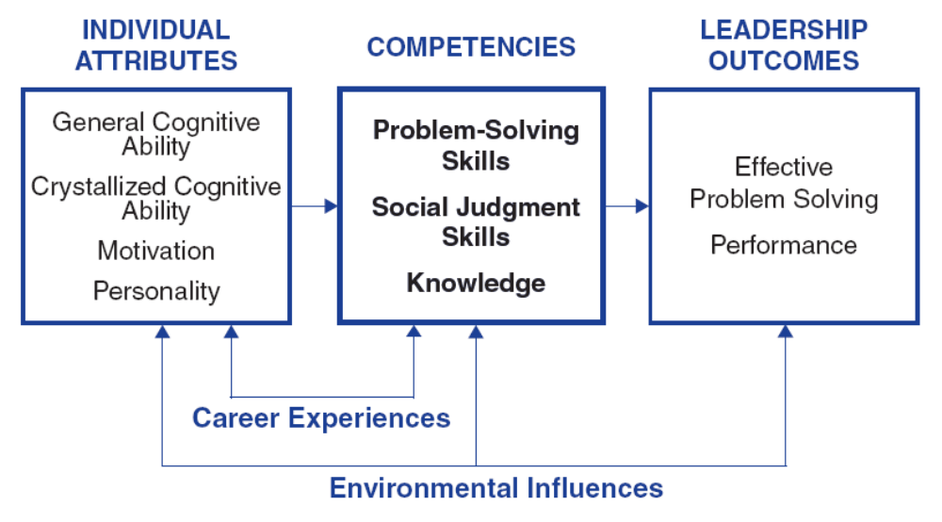
Skills Model
Skills Model of Leadership

Slide 16
Career Experiences
Career
Experiences
Challenging
Assignments
Mentoring
Appropriate
Training
Hands-on
Experience With
Novelty
Experience gained during career influences leader’s knowledge & skills to solve complex problems
Leaders learn and develop higher levels of conceptual capacity if they progressively confront more complex and long-term problems as they ascend the organizational hierarchy

Slide 17
Environmental Influences
Environmental
Influences
Factors
Outside of Leader’s
Control
Factors in a leader’s situation that lie outside of the leader’s competencies, characteristics, and experiences
  Outdated technology
  Subordinates’

Slide 18
How Does the Skills Approach Work?
Focus of Skills Approach
Strengths
Criticisms
Application

Slide 19
Skills Approach
Principal Research Perspectives
Focus
Focus is primarily descriptive – it describes leadership from skills perspective
Provides structure for understanding the nature of effective leadership
Katz (1955) suggests importance of particular leadership skills varies depending where leaders reside in management hierarchy
Mumford et al. (2000) suggest leadership outcomes are direct result of leader’s skilled competency in problem solving, social judgment & knowledge

Slide 20
Strengths
First approach to conceptualize and create a structure of the process of leadership around skills
Describing leadership in terms of skills makes leadership available to everyone
Provides an expansive view of leadership that incorporates wide variety of components (i.e., problem-solving skills, social judgment skills)
Provides a structure consistent with leadership education programs

Slide 21
Criticisms
Breadth of the skills approach appears to extend beyond the boundaries of leadership, making it more general/less precise
Weak in predictive value; does not explain how skills lead to effective leadership performance
Skills model includes individual attributes that are trait-like

Slide 22
Application
The Skills Approach provides a way to delineate the skills of a leader
It is applicable to leaders at all levels within the organization
The skills inventory can provide insights into the individual’s leadership competencies
Test scores allow leaders to learn about areas in which they may wish to seek further training

